Slide 1
Product Research
By Lupita Arita

Slide 2
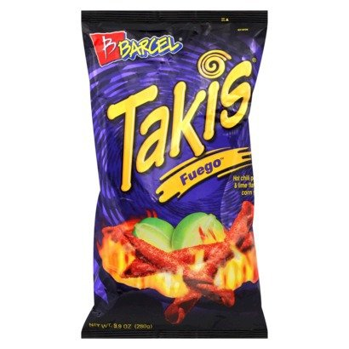
Takis
Price Range: 2.33-8.90
Product Specs:
Demand factors:
Spanish people like Takis
Takis very are popular
Supply factors:
Cheap labor from Mexico
Cheap materials
Elasticity:
This is an elastic if the price go up, people would buy other brands.

Slide 3
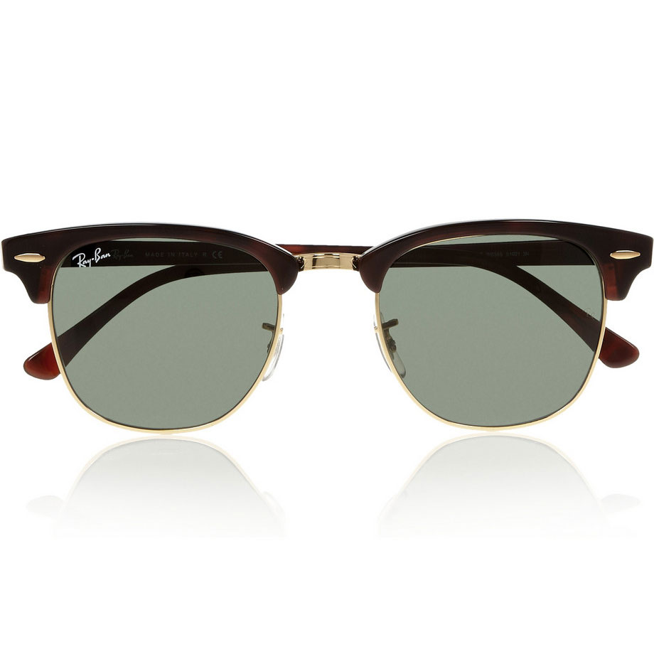
Ray-Ban
Price Range 94.99-168.95
Product Specs:
Demand factors:
Everyone likes Ray-Ban Sunglasses
It covers from the sun
Supply factors:
Good labor from Italy
Expensive materials
Elasticity:
This is an elastic if the price go up, people would buy other brands

Slide 4
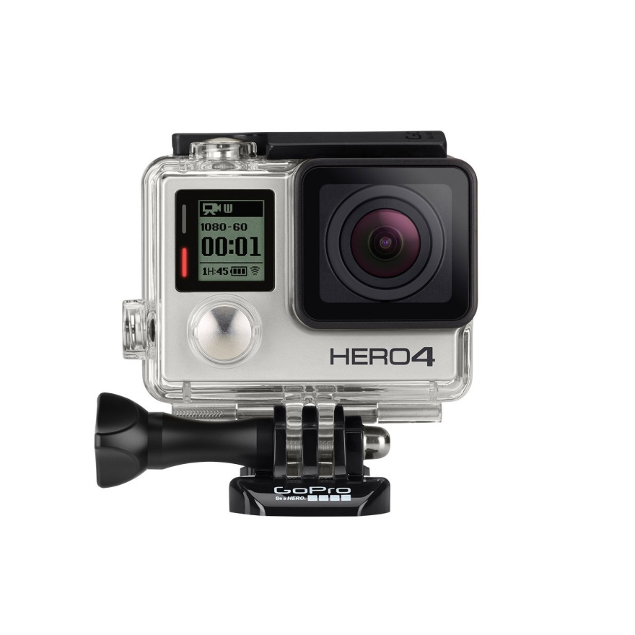
GoPro
Price Range 129.99-399.99
Product Specs:
Demand factors:
It is waterproof
Small + lightweight
Supply factors:
Labor from California
Expensive material
Elasticity:
This is an elastic if the price go up, people would buy other brands

Slide 5
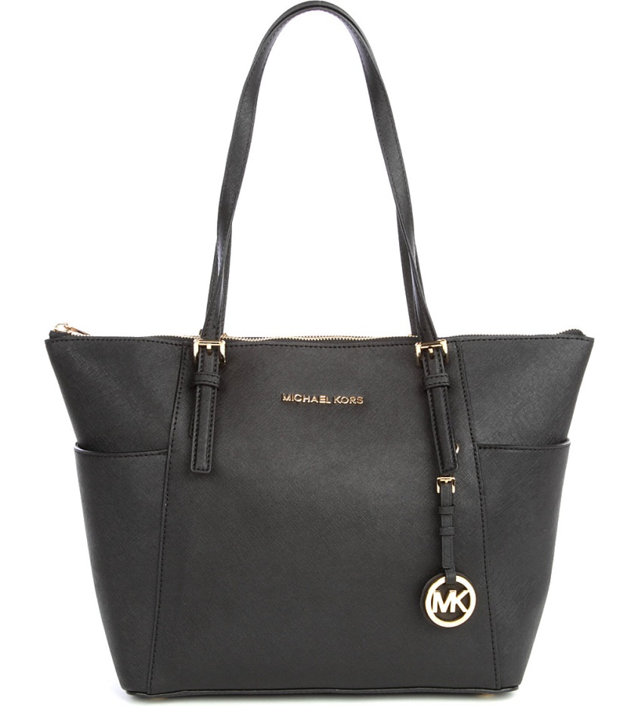
Michael Kors Handbags
Price Range 167.00-278.00
Product Specs:
Demand factors:
To carry stuffs
Is very useful
Supply factors:
Labor from China
Expensive materials
Elasticity:
This is an elastic if the price go up, people would buy other brands.

Slide 6
Book Album
Price Range 24.50-17.88
Product Specs:
Demand factors:
Preserve pictures
Keep the pictures clean
Supply factors:
Cheap labor from China
Cheap materials
Inelasticity:
This is an inelastic if the price go up people would still buy it.

Slide 7
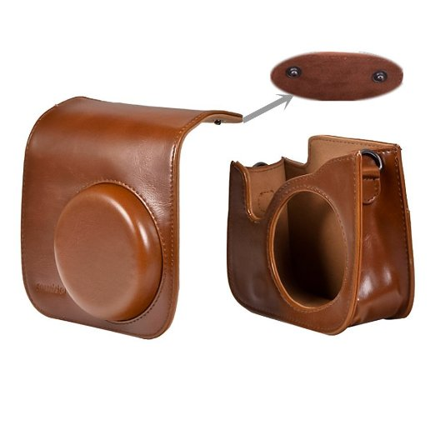
Leather Case Vintage Shoulder Bag
Price Range 11.98-23.24
Product Specs:
Demand factors:
Hang on the camera
the color is vintage and beautiful
Supply factors:
Cheap labor from China
Cheap materials
Inelasticity:
This is an inelastic if the price go up people would still buy it

Slide 8
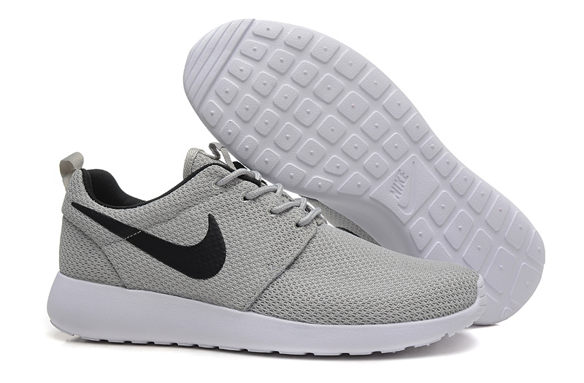
Nike Women’s Running Shoes
Price Range 78.98-90.00
Product Specs:
Demand factors:
As soon as you slip it on, you feel faster.
Vary comfortable
Supply factors:
Expensive labor from China
Expensive materials
Elasticity:
This is an elastic if the price go up, people would buy other brands.

Slide 9
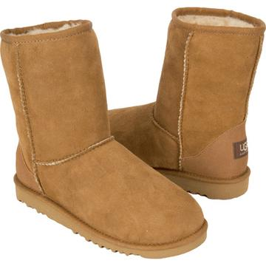
Ugg Women’s
Price Range 93.00-120.00
Product Specs:
Demand factors:
White people like Ugg’s
They are very popular
Supply factors:
Expensive labor from Australia
Confortable material
Elasticity:
This is an elastic if the price go up, people would buy other brands.

Slide 10
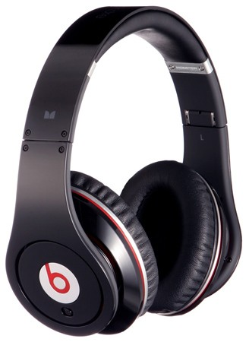
Beats Headphones
Price Range 129.99-134.99
Product Specs:
Demand factors:
Very good sound isolation
Reliable grip good for exercise
Supply factors:
Expensive labor from California
Good materials
Elasticity:
This is an elastic if the price go up, people would buy other brands.

Slide 11
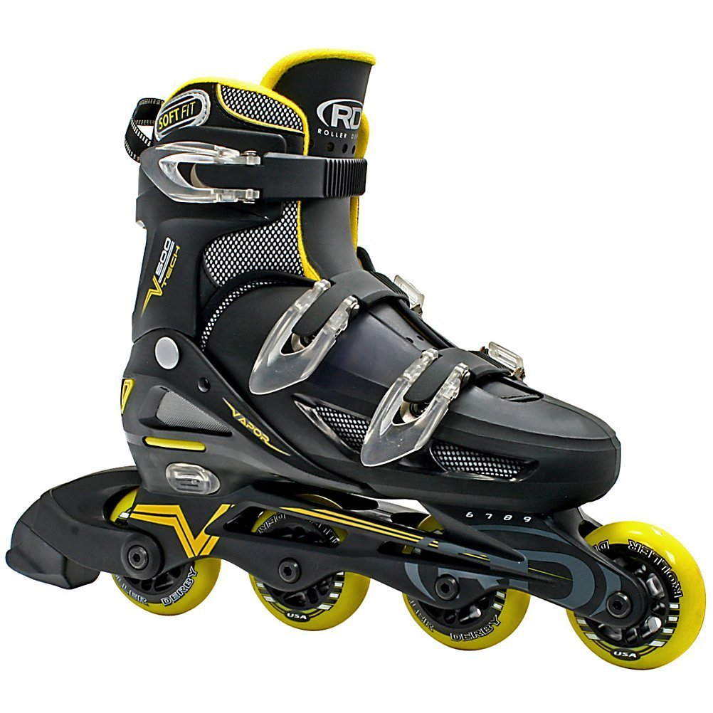
Ice Skates
Price Range 22.99-58.25
Product Specs:
Demand factors:
Its fun to go play in the summer
Is a good sport
Supply factors:
Labor from USA
Plastic materials
Elasticity:
This is an elastic if the price go up, people would buy other brands.

