Slide 1
Financial Goals
Lupita Arita

Slide 2
Long-Term Career Goal
I want to be a veterinary
I want this career
because I really like pets I love pets and I want to help the animals from my country because people don’t care about them in Honduras.
I would made an average of $91,250 per yea

Slide 3
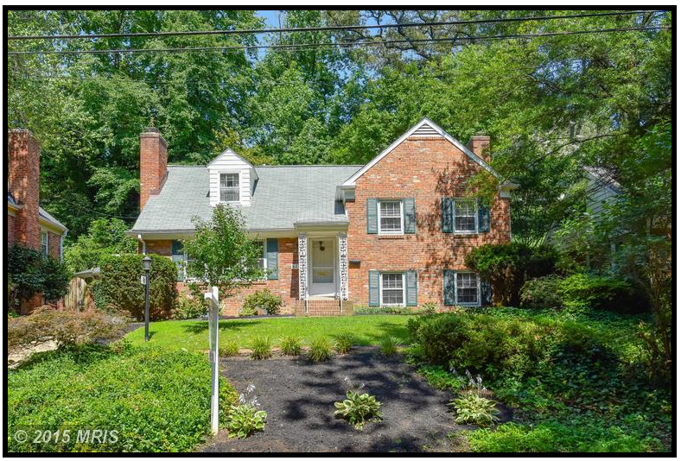
Long-Term House goals
I would like to buy a house with my future husband
Alexandria, Virginia
821 TIMBER BRANCH PARKWAY
Alexandria, VA 22302
The mortgage would be 695,000 dollars
I would pay $3,286 per month

Slide 4
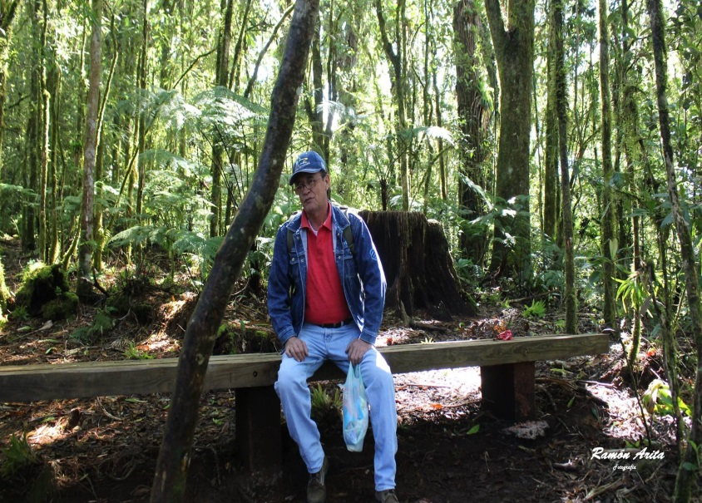
Long-Term Goal #3
I would like to bring my dad to the United States
He is in Honduras and I want him to be close to me because I miss him so much
It would cost me a lot of wait and be more patient

Slide 5
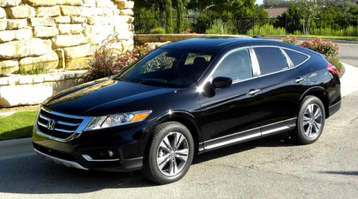
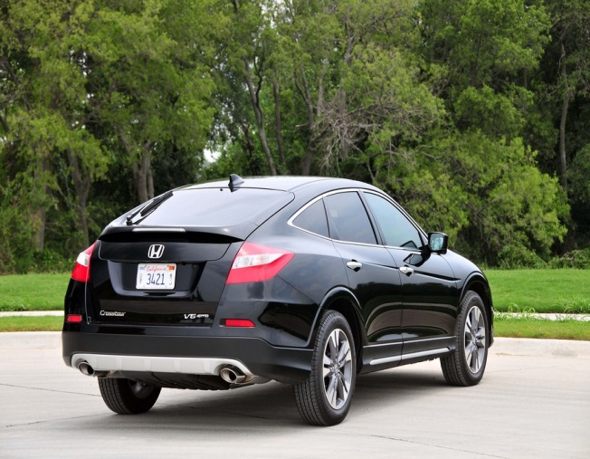
Long-Term Goal #4
Another thing that I would like to have is my own car
This is important to me because I would have an easy transportation and I would not have to take the bus anymore
It would cost me $27,530

Slide 6
Long-Term Goal #5
Another thing that I would like to have is a apple computer.
This is important because can do my work in the computer, is going to be more easy if I have one.
It would cost me $1,499.00

Slide 7
Summary of Long Term Goals
I am planning to earing around 150,000 dollars. I thing it would take me 20 years if I want to save that amount. If I want to save that much I would try not to spend that much in little things that I don’t really need.

Slide 8
How do I accomplish my Long-Term goals?
First, I would try to find a house here in Virginia because I really like living here. Second, I would save money to try and buy a car so I can move easily from one place to other. Third, I would try to bring my dad here to the United State so he can be with me and my sister. After that I would buy a dog because I really like animals and because of that I would not feel lonely.

