Slide 1
WISE Buyer versus Conspicuous Consumer By: Lupita Arita

Slide 2
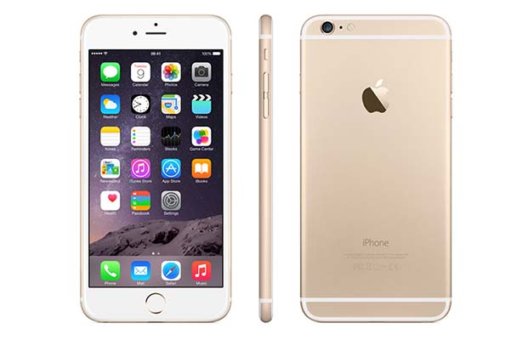
Conspicuous Buy: IPhone 6S
Apple IPhoneS6 (128GB)
Price: $6.99.99
Why is it conspicuous?
The IPhone 6S is the most wanted IPhone in the market right now
Why is it expensive?
This IPhone has 128gb and is the newest model

Slide 3
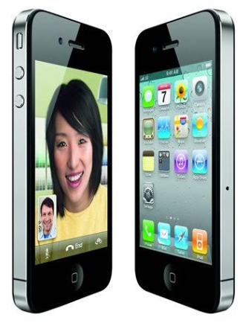
Wise Buy: IPhone 4
IPhone 4
Price: $ 104.99
Why is it WISE?
This tablet is cheaper but has similar functions
I sacrifice GB space but I don’t need them

Slide 4
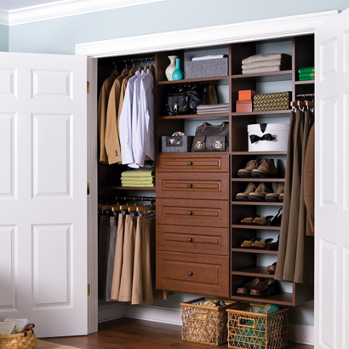
Conspicuous Buy: Chestnut Reach-In Closet
Closet
Price: $1,232.51
Why is it conspicuous?
- Oil-Rubbed Bronze Hardware
Why is it expensive?
- This is really big closet you can put a lot of things there

Slide 5
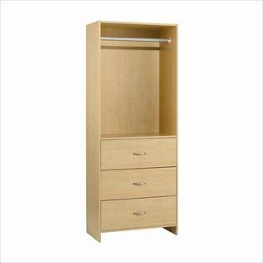
Wise Buy: Homestar Drawer Closet
Closet
Price: $132
Why is it WISE?
This closet is cheaper but has similar functions
You cannot put a lot of things in it.

Slide 6
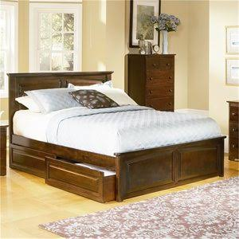
Conspicuous Buy: Monterey Platform Bed
The Monterey features an elegant raised panel headboard
Price: $800
Why is it conspicuous?
- Made of Eco-Friendly soil hardwood
Why is it expensive?
- This model is really soft and comfortable

Slide 7
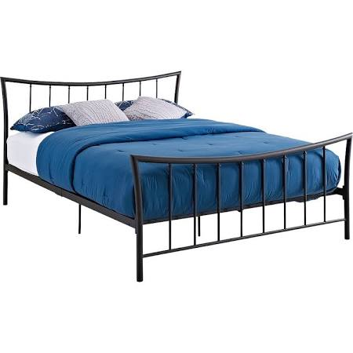
Wise Buy: Bali Metal Queen Bed Bronze
Bali Metal Queen Bed Bronze
Price: $117
Why is it WISE?
- This bed is cheaper but has similar functions
- Is not comfortable

Slide 8
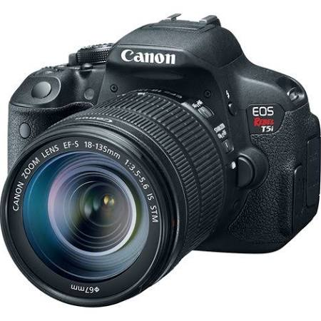
Conspicuous Buy: Canon Camera
Canon Camera 18.0 MP
Price: $649
Why is it conspicuous?
- Photo enthusiasts rejoice, The flagship of the spectacular rebel line
Why is it expensive?
- The incredible image quality and performance starts with an 18.0-megapixel.

Slide 9
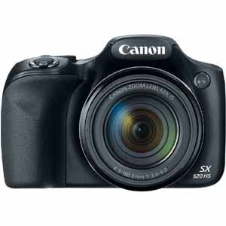
Wise Buy: Canon Power Shot Camera
Canon Power Shot Camera
Price: $200
Why is it WISE?
- This camera is cheaper but has similar functions
- It have 16.0 Megapixel with is a little bit less then other cameras

Slide 10
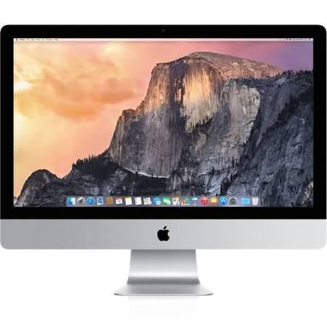
Conspicuous Buy: Apple iMac Computer
Apple iMac Computer
Price: $2,200
Why is it conspicuous?
- The Apple Computer is the most wanted computer in the market
Why is it expensive?
- This computer is fast 802.11ac Wi-Fi.

Slide 11
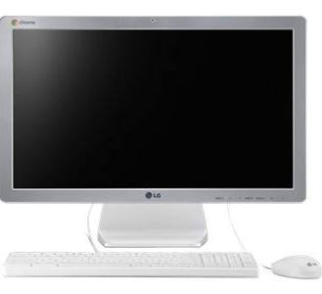
Wise Buy: LG Chromebase Computer
LG Chromebase Computer
Price: $300
Why is it WISE?
- This computer is cheaper but has similar functions
- Is less faster than others wants

Slide 12
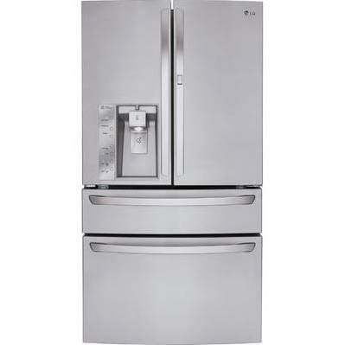
Conspicuous Buy: French Door Refrigerator
French Door Refrigerator
Price: $3,060
Why is it conspicuous?
The refrigerator provides customizable capacity for even more ways to use your space.
Why is it expensive?
- It reduce cold air loss up to 47% to help keep foods, fresher longer.

Slide 13
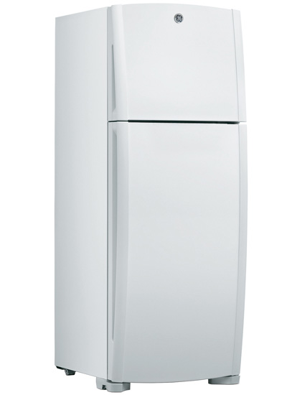
Wise Buy: Top Freezer Refrigerator
Top Freezer Refrigerator
Price: $324
Why is it WISE?
- This Refrigerator is cheaper but has similar functions
- It doesn't have enough space to keep a lot of food.

Slide 14
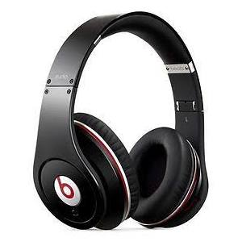
Conspicuous Buy: Beats
Beats
Price: $249.50
Why is it conspicuous?
- This Beats are the most wanted headphones in the market
Why is it expensive?
- Provides superior comfort for hours of listening

Slide 15
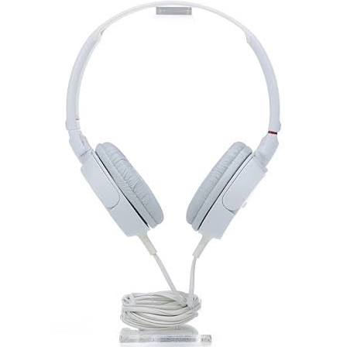
Wise Buy: Sony Headphones
Sony Headphones
Price: $11
Why is it WISE?
- This Headphones is cheaper but has similar functions
- They are not confortable, and you can hear noises.

Slide 16
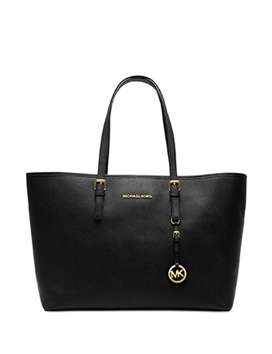
Conspicuous Buy: Michael Kors Purse
Michael Kors Purse
Price: $398
Why is it conspicuous?
- The Purse is the most wanted Purse Michael Kors in the market
Why is it expensive?
- This bag will be the perfect go-to bag for you work or play, day or night.

Slide 17
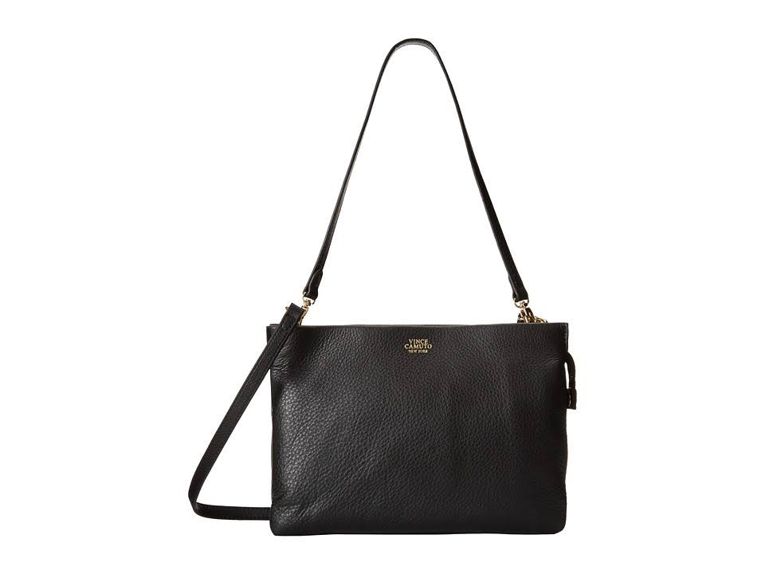
Wise Buy: Vince Camuto Purse
Vince Camuto Purse
Price: $198
Why is it WISE?
- This purse is cheaper but has similar functions
- Is small than others, and no body wants it.

Slide 18
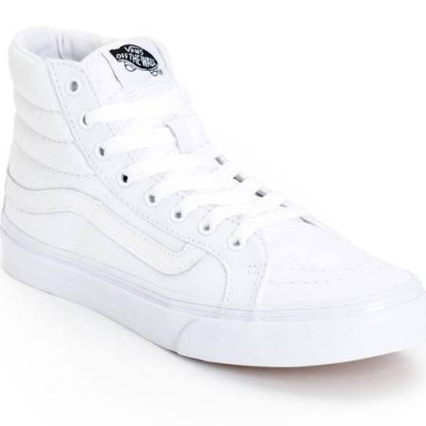
Conspicuous Buy: White Vans Girls
White Vans Girls
Price: $55.99
Why is it conspicuous?
- The Vans is the most wanted Vans in the market right now for girls
Why is it expensive?
- This Vans are in Trendy right now and that’s why they are really expensive.

Slide 19
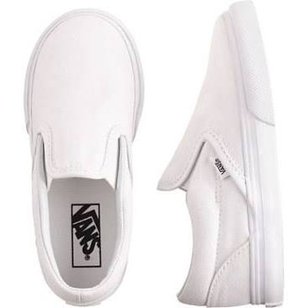
Wise Buy: Crewcuts Vans
Crewcuts Vans
Price: $30
Why is it WISE?
- This Vans is cheaper
- They were in trendy in 2011 and now people are looking for 2015 Vans new model

Slide 20
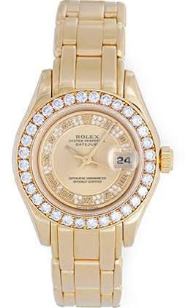
Conspicuous Buy: Gold Watch Myriad Roman Diamond
Gold Watch Myriad Roman Diamond
Price: $18,800.00
Why is it conspicuous?
- Is 31 jewels, Quickset, sapphire crystal.
Why is it expensive?
- This watch is really expensive because is all gold and some diamond all around.

Slide 21
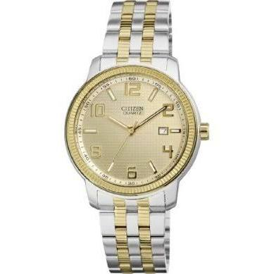
Wise Buy: Japanese Quartz Two Tone Watch
Japanese Quartz Two Tone Watch
Price: $199.95
Why is it WISE?
- This watch is cheaper but has similar functions than the expensive one
- Is not all gold and that’s why is not expensive

